Slide 1
First semester code
Adriana Martinez

Slide 2
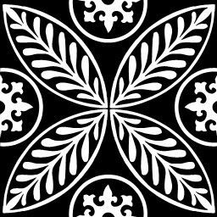
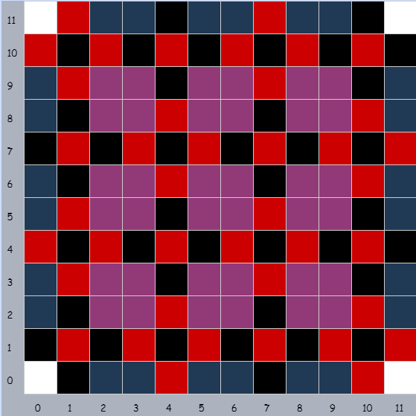
01_Patterns
Created in Grid
Black cross with red center
Red cross with black center
Filled in squares purple
Blue edges
White corners

Slide 3
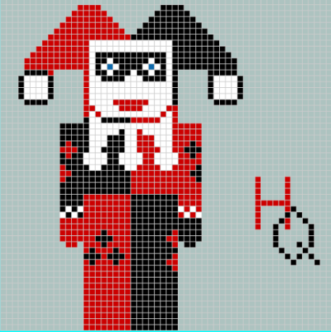
02_Pixel art
Created in grid
Made as symmetrical as possible
Hardest part was collar
Used phone case as reference

Slide 4
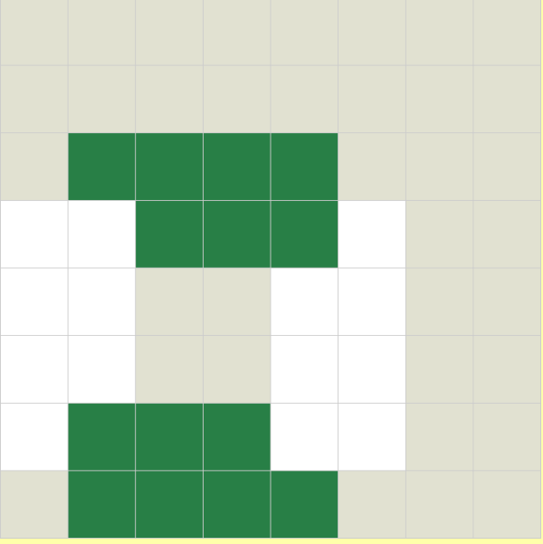
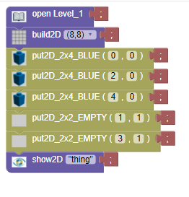
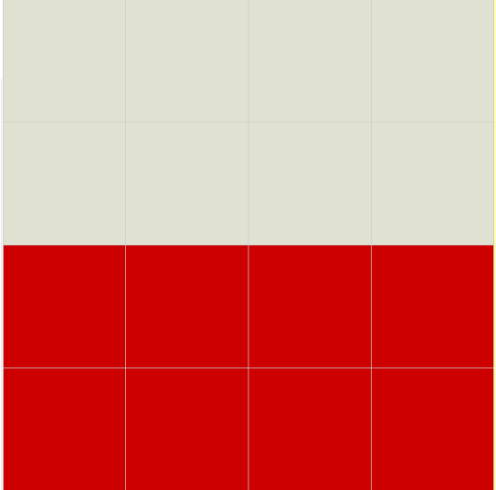
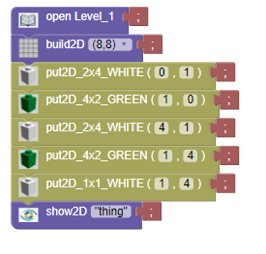
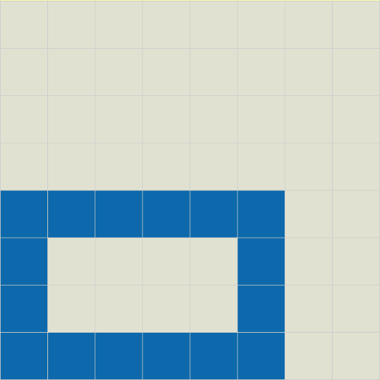
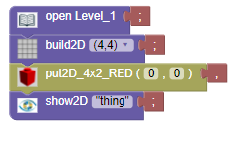
04_objects in bricklayer-lite
Done in bricklayer-lite Lvl 1
Basic alternating done in first one
Used empty to creat rectangle in second one
Just one 4x2 red in third

Slide 5
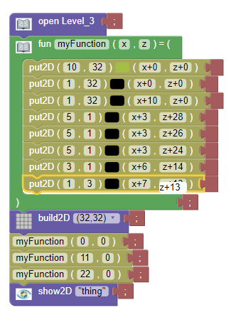
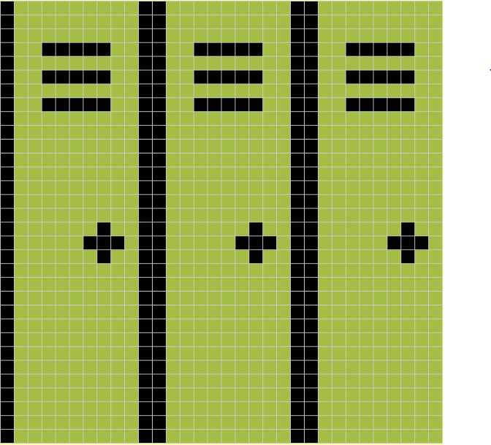
05_Objects around Bryan in bricklayer-lite
Created in Bricklayer-lite
Made one function and just repeated it
No offsets

Slide 6
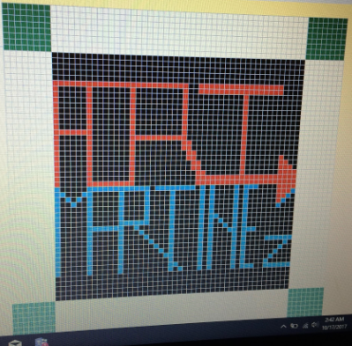
06_Name project
Created in Bricklayer-Lite
Used offsets for white blocks on edge
Didn’t reuse letter R because of spacing
Reused A

Slide 7

07_Flag project
Created four white rectangles
Two red strips
Black outline
Used offsets to replicate
Would have been easier to just make white rectangles a giant 32x16 box, so would change that if I could go back

Slide 8
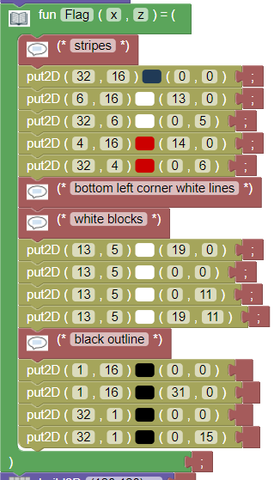
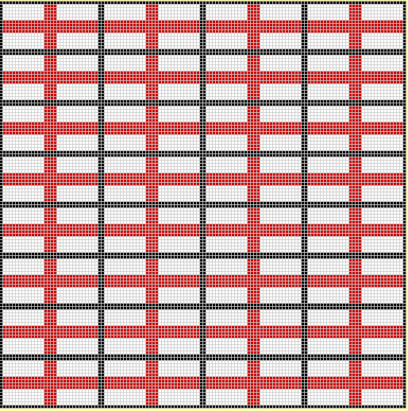
07_flag project

Slide 9

07_Flag project part two
Created Norway flag
Red 32x16 box
Two white stripes
Two blue stripes
Copied English flag function
Used offsets

Slide 10
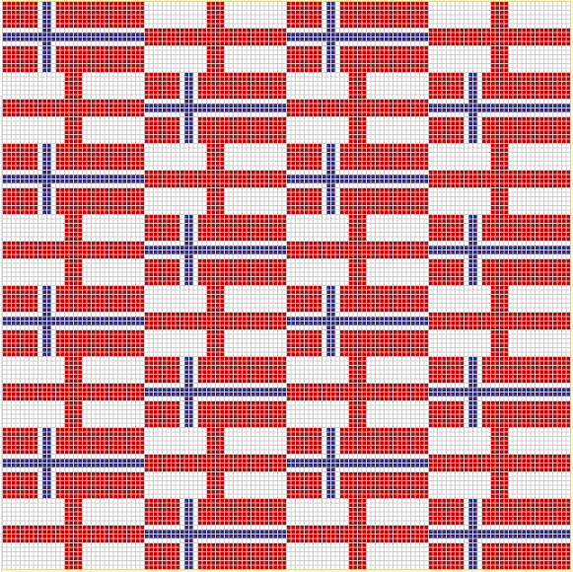
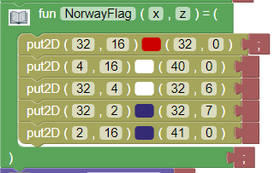
07_Flag project

Slide 11
08_More patterns
Red line next to black line
Made on 128x128 grid
Used offsets to move around grid

Slide 12
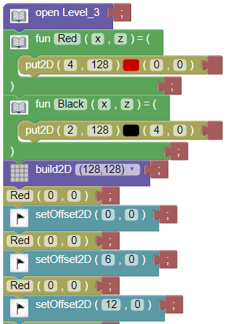
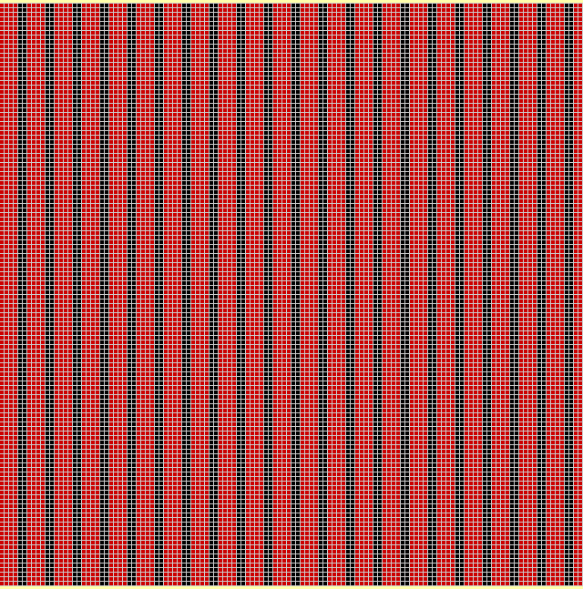
08_More patterns

Slide 13
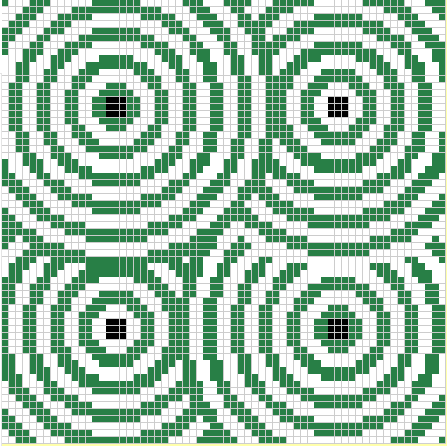
10_Ring circle pattern
Made in Bricklayer-Lite
Made two functions
One with white then green
One with green then white
Layered the functions on top of each other

Slide 14
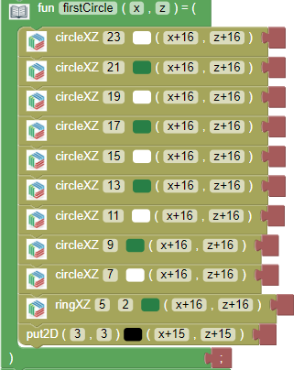
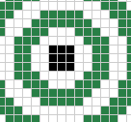
10_ring circle pattern

Slide 15

11_All Functions
Used purple circle to make body
Lines to make tail and front of fish
Black dot for eye

Slide 16
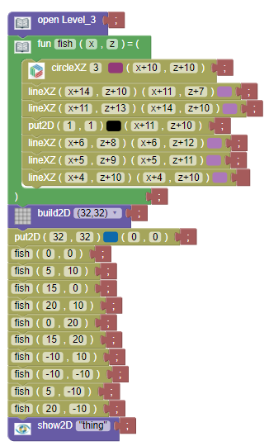
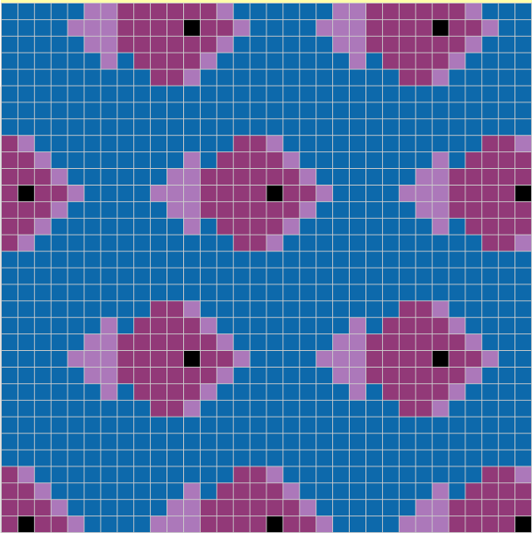
11_All functions

Slide 17
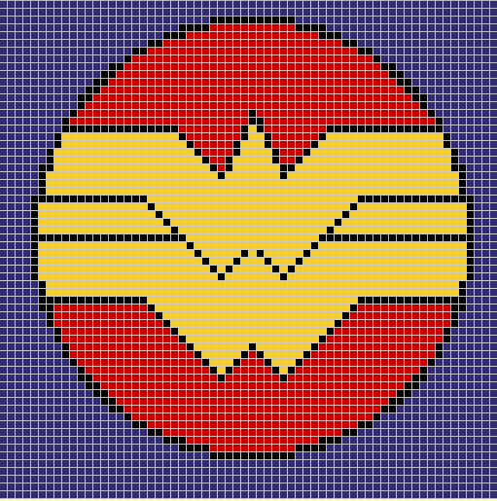
12_Real image
Wonder Woman Logo
Made in Bricklayer-Lite
Blue background
Red circle
Black ring

Slide 18
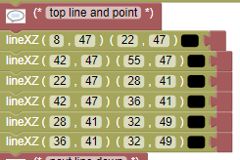

12_Real image

